Slide 1

LLM Supercharging with RAG
Bridging the Gap Between Foundation Models and Proprietary Data

Slide 2

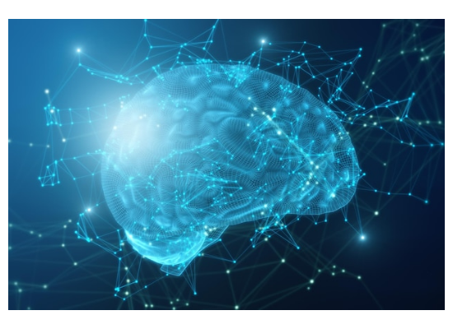
The Landscape: GenAI & LLMs
Understanding the Core
Generative AI (GenAI): The overarching class of AI algorithms capable of creating new content—text, images, audio, or code—based on learned patterns.
Large Language Models (LLMs): A highly specialized subset of GenAI trained on massive text datasets to understand, translate, and generate human-like language.
The Foundation: Models are trained via next-token prediction, acting as advanced reasoning engines rather than traditional databases.

Slide 3









The Key Players & Ecosystem
OpenAI
Anthropic
Claude
Pioneers of the modern generative era. Creators of the GPT series (GPT-3, GPT-4), which set the benchmark for conversational AI and reasoning capabilities globally.
An AI safety and research company founded by former OpenAI engineers. Focuses on building reliable, interpretable, and steerable AI systems via Constitutional AI.
Anthropic's flagship LLM family. Known for industry-leading context windows, nuanced understanding, and reduced hallucination rates compared to peers.

Slide 4
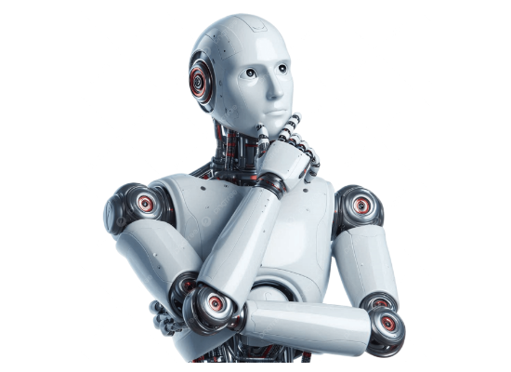
The Limitation of Base LLMs
Why do we need more?
The Knowledge Cutoff: Base LLMs are frozen in time. They cannot access events or information created after their training phase ended (Stale Data).
Hallucinations: When forced to answer questions outside their training data, models often generate plausible-sounding but entirely fabricated responses.
Data Privacy Gap: Public LLMs have zero visibility into your private corporate documents, internal wikis, or proprietary databases.

Slide 5
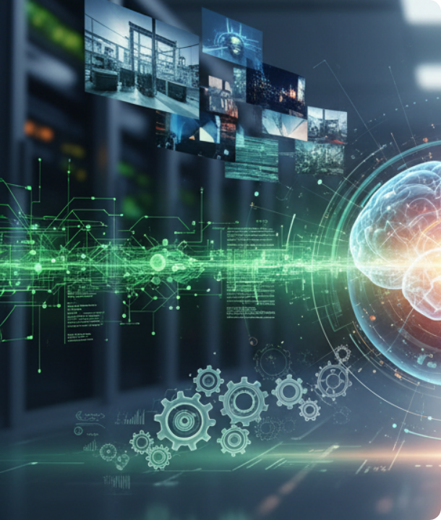
What is RAG?
Retrieval-Augmented Generation
RAG is an architectural framework that bridges the gap between an LLM's static training and your dynamic data.
Instead of relying solely on the model's internal memory, RAG intercepts the user's prompt, retrieves highly relevant facts from an external knowledge base, and augments the prompt with this context.
The LLM then acts as a reasoning engine over the provided facts, ensuring accurate, verifiable, and private answers.

Slide 6







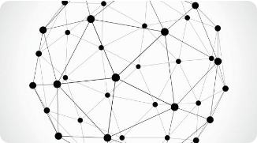
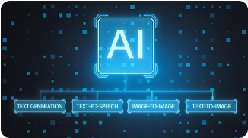
Core Architecture of RAG
1. Ingestion
2. Embedding & Vector DB
3. Retrieve & Generate
Raw documents (PDFs, Confluence, DBs) are ingested, cleaned, and broken down into smaller, manageable "chunks" of text to maintain specific context.
A user queries the system. The DB finds the most semantically similar chunks. These chunks are injected into the LLM's prompt to generate a grounded response.
Chunks are converted into dense mathematical vectors (embeddings) and stored in a Vector Database. This allows for rapid semantic search based on meaning, not just keywords.

Slide 7


Emerging Standards: MCP
Model Context Protocol
Why MCP Matters for RAG
Introduced by Anthropic, MCP is an open standard designed to solve the fragmentation of connecting AI models to external tools.
Universal Integration: Build one MCP server, and any supporting LLM (Claude, etc.) can securely access that data source.
Traditionally, every data source required a custom API integration for an LLM to access it. MCP standardizes this connection.
Enhanced Security: Standardized authentication and access controls for private enterprise data.
Future-Proofing: Abstracts away the complexity of tool-calling, making highly advanced agentic RAG setups easier to deploy.

Slide 8
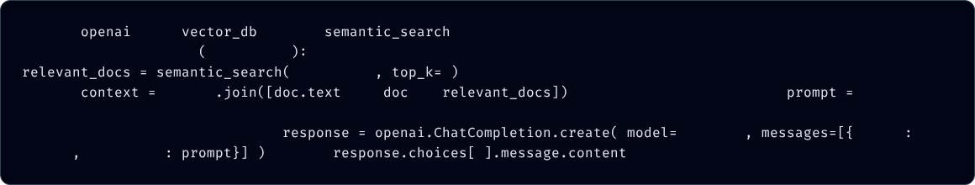
RAG in Practice: Python Example
A simplified conceptual view of a RAG pipeline using Python:
import
from
import
# Hypothetical Vector DB client
def
generate_rag_response
user_query
# 1. Retrieval: Fetch top 3 relevant text chunks from our private DB
# 2. Augmentation: Combine retrieved docs into a context string
user_query
3
f"Use the following context to answer the user.\n\nContext:\n{context}\n\nQuestion: {user_query}"
"\n\n"
for
in
# 3. Prompt Construction
# 4. Generation: Pass the grounded prompt to the LLM
"gpt-4o"
"role"
"user"
"content"
return
0

Slide 9
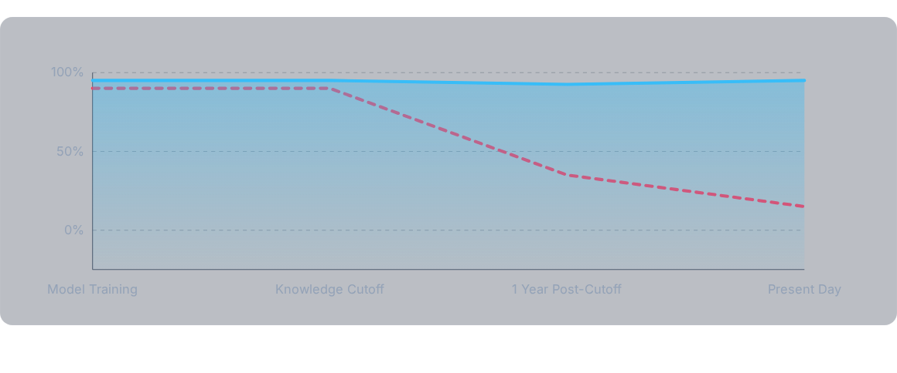
Knowledge Accuracy Over Time
Base LLM (Static)

Slide 10
Questions?
Ready to build your first RAG pipeline?

Slide 11






Image Sources
https://img.freepik.com/premium-photo/artificial-intelligence-machine-learning-concept-with-blue-glowing-digital-human-brain-with-convolutions-inside-surrounded-by-neural-net-abstract-dark-background-3d-rendering_670147-11698.jpg
Source: www.freepik.com
https://png.pngtree.com/png-clipart/20240717/original/pngtree-thinking-robot-png-image_15573149.png
Source: pngtree.com
https://www.innoflexion.com/storage/2025/10/Gemini_Generated_Image_8j95tw8j95tw8j95.png
Source: www.innoflexion.com
https://png.pngtree.com/thumb_back/fw800/background/20251219/pngtree-futuristic-digital-data-center-with-glowing-blue-server-racks-and-abstract-image_20880292.webp
Source: pngtree.com
https://media.istockphoto.com/id/521576619/vector/icosahedron.jpg?s=612x612&w=0&k=20&c=WbDIenGjV-rLWuJj5GjMxrD9igMZfegyy87ZLSz6g-I=
Source: www.istockphoto.com
https://img.freepik.com/premium-photo/creative-ai-interface-blurry-background-artificial-intelligence-innovation-robotics-concept-3d-rendering_670147-60678.jpg
Source: www.freepik.com

